Slide 1


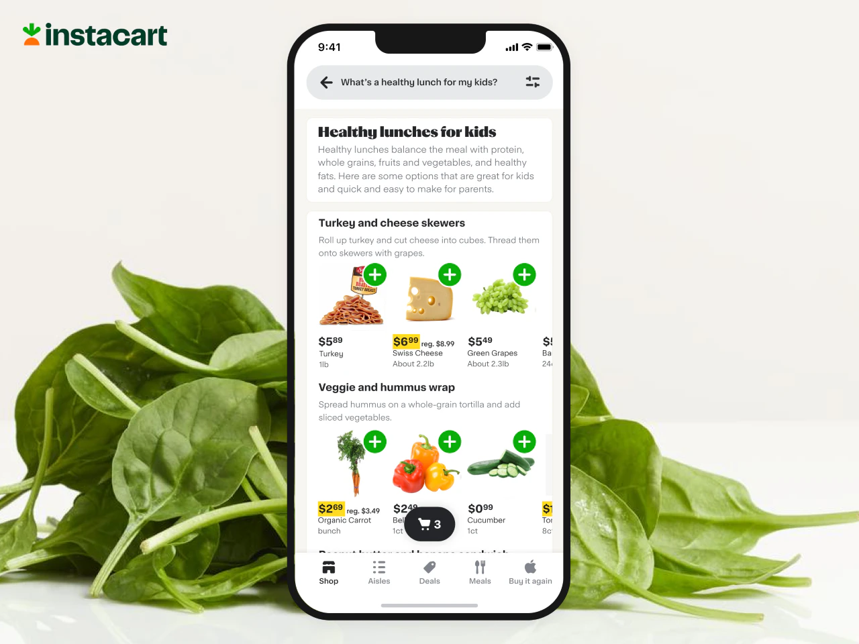


DIMENSIONAL MODELING
CUSTOMER BEHAVIOUR
ANALYSIS

Slide 2






Project
Objectives
01
Optimizing Resource Allocations
Enhancing Customer Attraction Strategies
02
03
Reduce Operational
Costs
Improving Marketing Effectiveness
04

Slide 3


DATASET GENERAL INFORMATION
The dataset is released under the CC0: Public Domain license, permitting unrestricted use, including commercial purposes
Scope
Transactional data from Instacart focuses on customer purchasing patterns
Licensing
Content
Distribution
Hosted and distributed by Kaggle, a Google subsidiary. It is tagged for use in research on online communities
3 million Instacart orders of 200,000 users & 33+ million records of product in orders
Updates & Provenance
Updates frequently on discussion boards.
The provenance is listed as Google, suggesting data processed or hosted on Google's services
Accessibility
Available on Kaggle

Slide 4

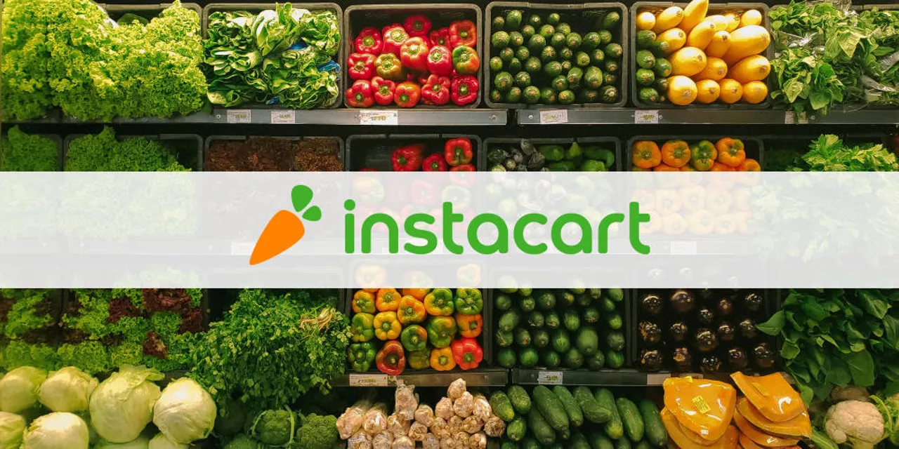





WHY THIS DATASET?
Real-world transactional data
Solving real-world business problems
Customer behavior
Released by Instacart
Educational & research purposes
A clean dataset
Suitable for dimensional modeling & data analysis
Why?

Slide 5

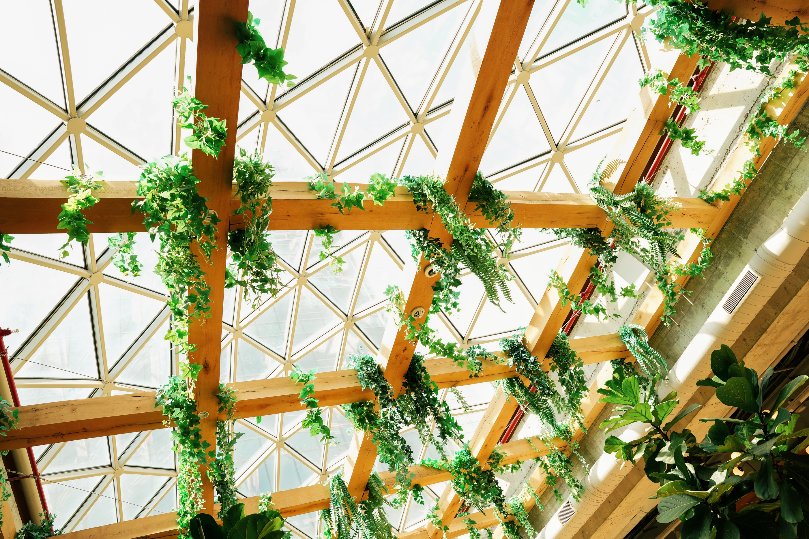




BUSINESS QUESTIONS
Resource Allocation
Operation
Optimization
Loyal Customers
What is the most popular product being bought?
At what time do customers often make an order with “Banana”?
What are the most/least popular departments and aisles?
Which is the busiest time of the day when customers make an order?
What are 5 best selling products during rush hours?
Which aisle/department has the most orders during the busiest hour?
How many people order more than 50 times already?
Who takes longer than 25 days apart to make an order?
What are the possible solutions to retain customers?

Slide 6
EXPECTED MODIFICATIONS
AND CONCERNS
Concerns
Expected Modifications
Larger dataset
Time consuming
Instance issues
Generalization of the Model
Transferred dataset to Google Drive
Combine data files
Resolve null values

Slide 7
DIMENSIONAL MODELING
Table 1: Products | Table 2: Order_products_prior | Table 3: Order_products_train | Table4: Aisles | Table5: Departments | Table 6: Orders
product_id | order_id | order_id | aisle_id | department_id | order_id
product_name | product_id | product_id | aisle | department | user_id
aisle_id | add_to_cart_order | add_to_cart_order |  |  | eval_set
department_id | reordered | reordered |  |  | order_number
 |  |  |  |  | order_dow
 |  |  |  |  | order_hour_of_day
 |  |  |  |  | days_since_prior_order
49.5 thousand rows | 32 millions rows | 1.4 million rows | 134 rows | 21 rows | 3.4 million rows

Slide 8

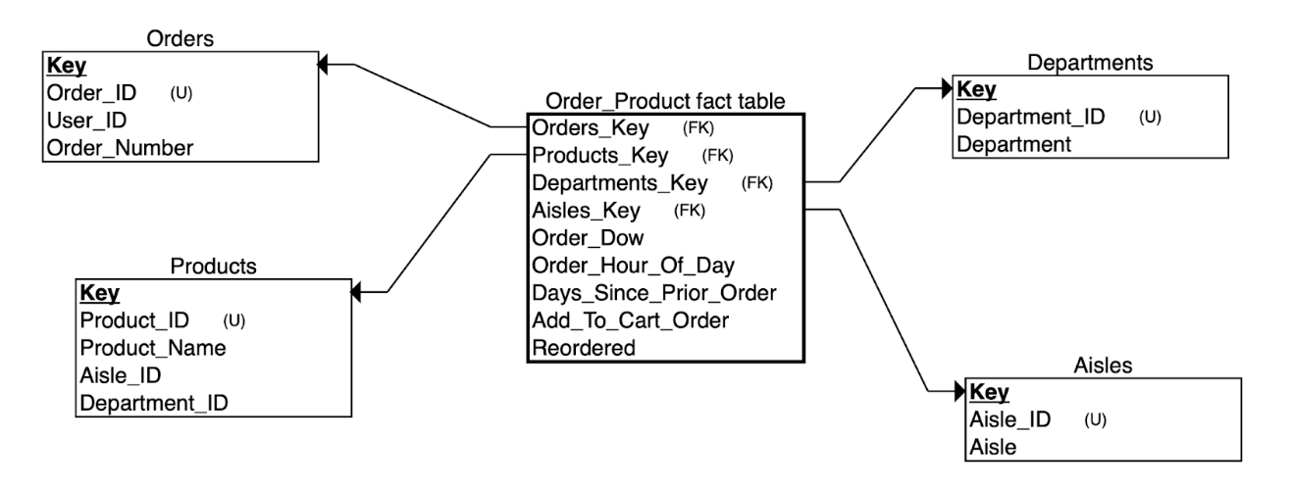
DIMENSIONAL SCHEMA
Manager

Slide 9

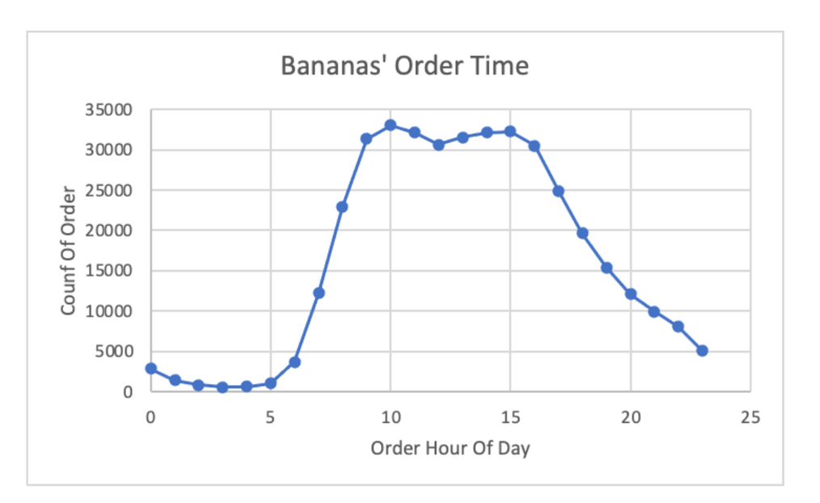
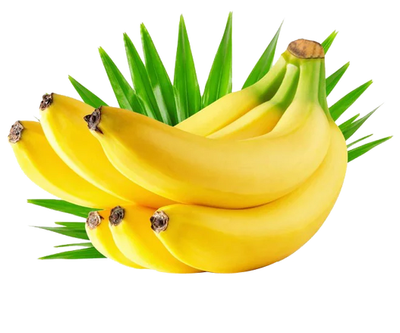
BQ1
RESOURCES ALLOCATION
What is the most popular product being bought?
At what time do customers often make an order with “Banana”?
491,291 times.
10am - 33,063 times
3pm - 32,253 times

Slide 10
What are the most popular departments and aisles?
BQ1
Departments
Aisles
Produce | Dairy Eggs | Beverages
2.51M orders | 2.26M orders | 1.52M orders
Fresh Fruits | Fresh Vegetables | Packaged Vegetables Fruits
1.86M orders | 1.49M orders | 1.23M orders
What are the least popular departments and aisles?
Pets | Alcohol | Babies
62K orders | 88K orders | 184K orders
Frozen Juice | Beauty | Baby Bath Body Care
4,488 orders | 6,111 orders | 8,257 orders

Slide 11




BQ1
BUSINESS GROWTH SUGGESTIONS
Banana Stocking Strategy: Replenish banana supply during off-peak hours (7 AM and post-8 PM) to enhance labor efficiency and maintain fresh stock.
Aisle Placement Tactics: Position bananas adjacent to less frequented aisles such as 'Frozen Juice', 'Beauty', and 'Baby Bath Body Care' to boost cross-selling opportunities.
App Display Optimization: Sequence 'Frozen Juice', 'Beauty', and 'Baby Bath Body Care' products immediately following bananas on the Instacart app to encourage purchases from these categories.
Food Waste Mitigation: Implement 'buy one get one free' offers for bananas approaching expiration to increase sales and reduce waste.
Innovative Revenue Streams: Introduce in-store pop-up smoothie stations utilizing fresh produce to minimize food waste and drive additional revenue.
Data-Driven Supply Chain: Leverage sales data to forecast demand accurately, ensuring optimal orders are placed with farms and suppliers.

Slide 12
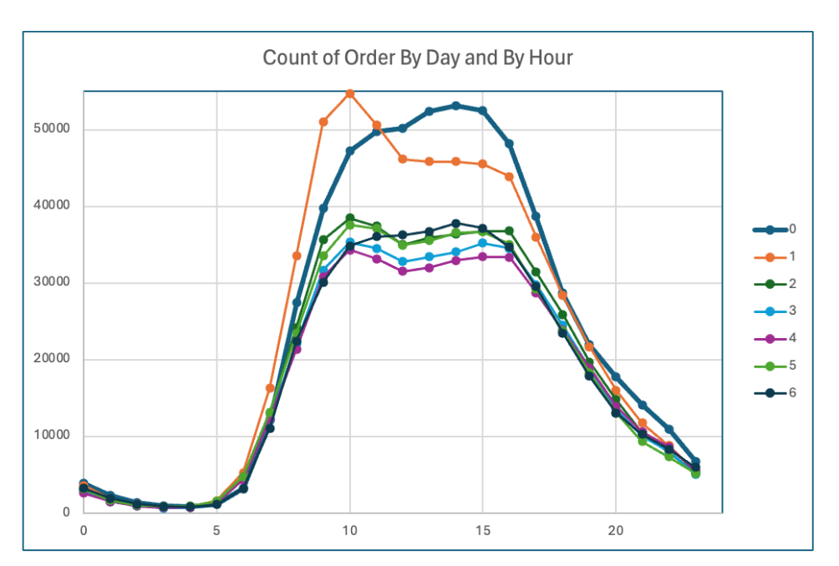
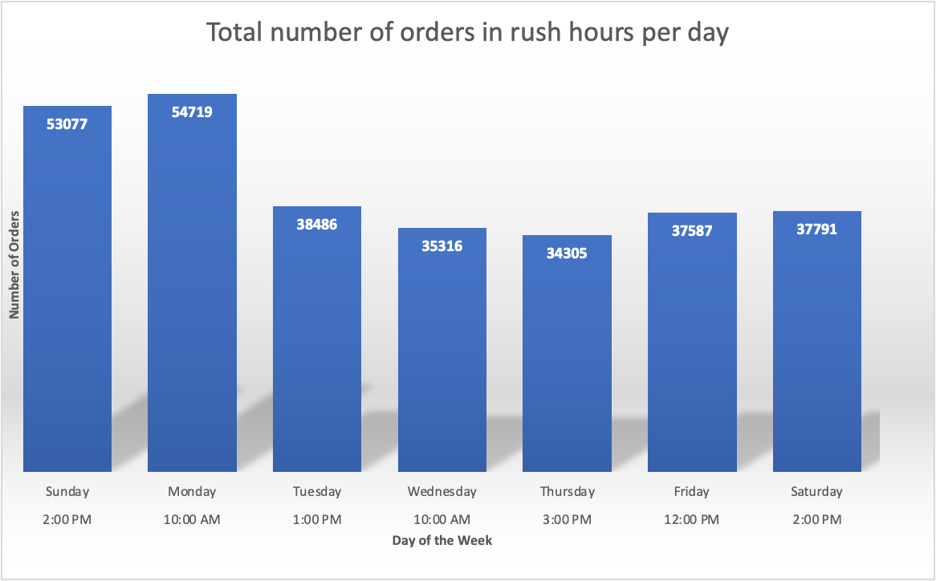
BQ2
OPERATION OPTIMIZATION
What is the busiest time of the day when customers make an order?

Slide 13

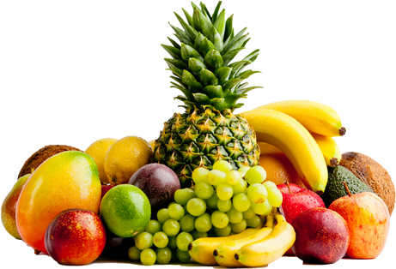
BQ2
What are top 5 best-selling products during that time?
Which department is popular in that busy hour?
Which aisle is the most popular during the busiest hour?
product_name | orders
Banana | 9,147
Bag of Organic Bananas | 6,713
Organic Baby Spinach | 5,280
Organic Strawberries | 5,065
Organic Hass Avocado | 4,203
department | orders
produce | 43,349
dairy eggs | 38,395
beverages | 23,829
snacks | 23,556
frozen | 22,514
aisle | orders
fresh fruits | 32,612
fresh vegetables | 28,955
packaged vegetables fruits | 23,121
yogurt | 15,724
packaged cheese | 14,332

Slide 14


BQ2
BUSINESS GROWTH SUGGESTIONS
Inventory and Operation Optimization: Utilizing the output, we can streamline our inventory management, allocate labor resources effectively, and enhance our supply chain efficiency. This strategic approach enables us to align our resources with customer demands, ensuring a seamless and efficient operation that meets the needs of our busy hours.
Labour Force Scheduling: We were able to generate the busiest time of each day. During the weekdays, the busiest time for the customers to place an order is between 10am - 3pm, while on the weekends, the customers often place orders at 2pm. Thus, we can organize the labor force of the market and have their schedule working around our busiest time.
Inventory and Supply Chain Management: In addition, understanding which products receive the most orders, and which departments and aisles get the most traffic during rush hours, allows us to organize storage/inventory and the supply chain with suppliers more efficiently and reasonably.
For example, during the peak hour on Sunday, there are more than 30,000+ orders that contain fresh fruits. We can provide a better working schedule of the employees on the fresh fruits aisle during the time.

Slide 15




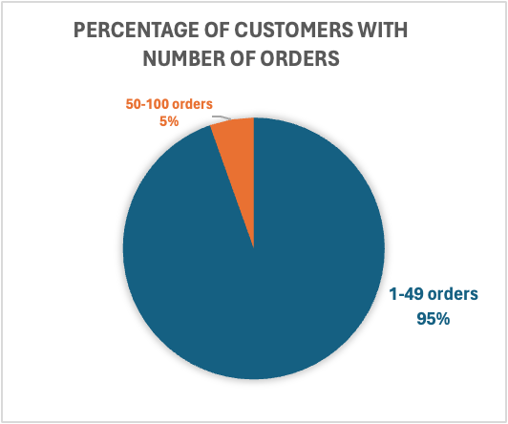

BQ3
LOYAL CUSTOMER
Order_number | Orders
100 | 867
99 | 1405
98 | 1452
97 | 1501
96 | 1569
95 | 1631
94 | 1695
93 | 1746
92 | 1819
91 | 1888
Who are our loyal
customers?

Slide 16


BQ3
User_ID | Orders
21 91562 | 12
11 024891 | 11
11 63097 | 11
01 754551 | 10
01 669451 | 10
01 790551 | 10
01 937251 | 10
01 088331 | 10
01 583541 | 10
01 68231 | 10
Who takes longer than 25 days apart to make an order?
How can we retain them ?

Slide 17
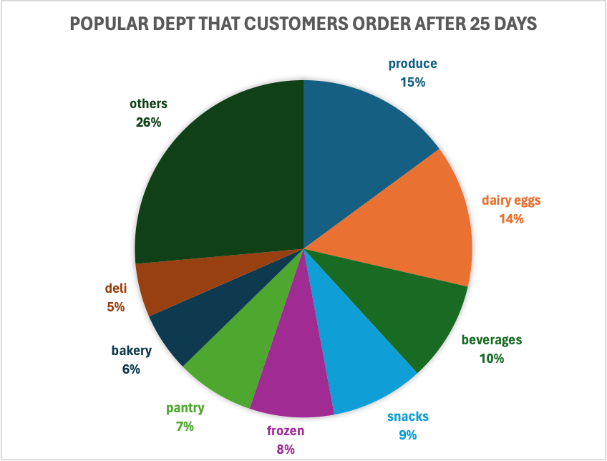
BQ3
What do they purchase?
BEHAVIORS
25 days since
placing a new order
TIMES
=< 12 times
PEOPLE
150k+
PRODUCT
3500+ types

Slide 18
BQ3
BUSINESS GROWTH SUGGESTIONS
Implementing a strategy of giving discounts to customers who haven't reordered in the past 25 days and providing membership discounts to those who have purchased at least 50 times in the past can have several potential benefits for a business:
Growth Of Membership Program: Providing 30% membership discounts to customers who have made at least 50 purchases demonstrates appreciation for their loyalty. Customers will feel that they are getting discounts, which motivates them to continue the membership of Instacart. This will directly increase the sales and revenue. On the other hand, these customers will keep using Instacart for next year too.
Customer Retention: Offering a 20% discount on the next purchase to customers who haven't placed an order in the last 25 days can serve as a motivating incentive for them to shop. In this way Instacart can retain customers by encouraging them to make another purchase rather than exploring alternative platforms such as other grocery shops / shopping app.
Improve Reorder Rate: Another alternative option to improve re-order rate and to encourage customer loyalty of these customers (who hasn't placed another order after 25 days) is to issue coupons for the department where they tend to shop often such as produce, dairy eggs, and beverages to incentivize future purchases.

Slide 19
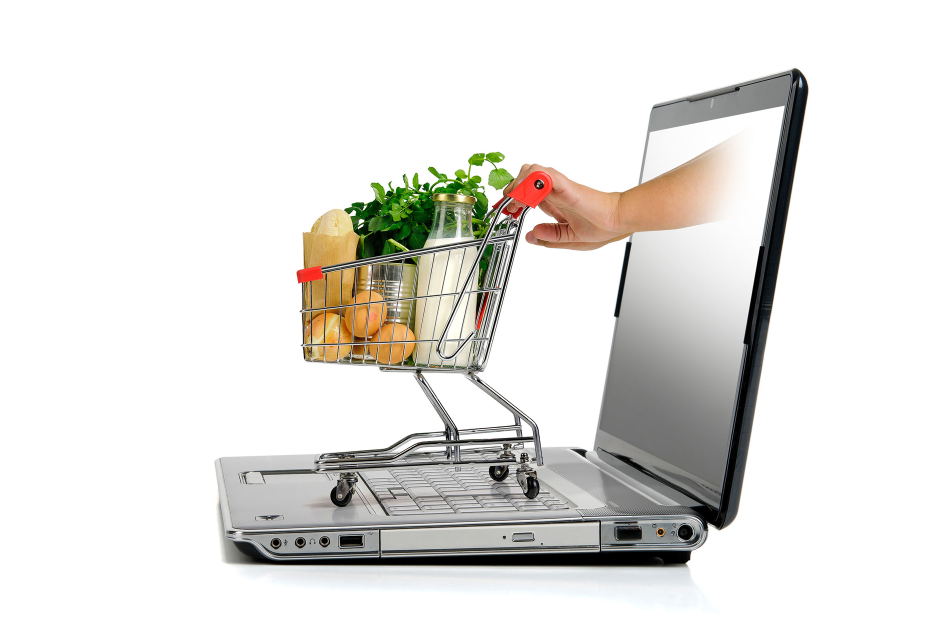
THANK YOU

